Slide 1
Intro to 3D Printing

Slide 2
Let’s Learn 3D Printing!
Overview of the 3D Printing Technology
Empower you to explore and answer your own questions.
Notes:
The goal of this workshop isn’t to make you a 3D Printing expert. It’s to give you enough knowledge on the technobabble and trends surrounding 3D Printing so that you are empowered to go out there and be able to solve your own problems that may arise. By the end of this workshop, you should be able to answer these questions.
How does 3D Printing Work?
Why 3D Print and who uses it?
How do I use a 3D Printer?
Logistics

Slide 3
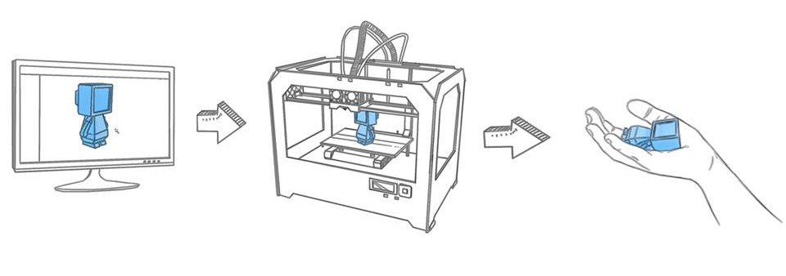
What is 3D Printing?
A digital model is transformed into a physical object, by laying down thin layers of material.
Notes:
Additive manufacturing process. A digital blueprint, called the 3D Model, is made into an object by a machine.

Slide 4
How does a 3D Printer Work?
Digital Blueprint
Sliced into Layers
Sent to the Printer
Notes:
When we use a regular printer, we have a design or word file, same with 3D printing. But unlike a 2 dimensional image, a physical object is 3D, so our Digital Blueprint must be 3D as well.

Slide 5
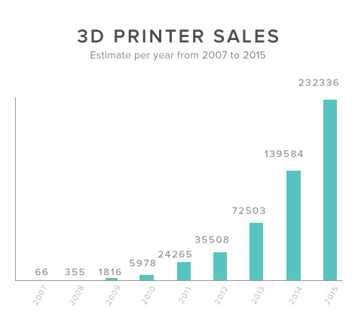
Brief History
Invented in 1983
FDM Patent expired in 2009
$200,000 3D Printers became $2000
number doubles every year

Slide 6
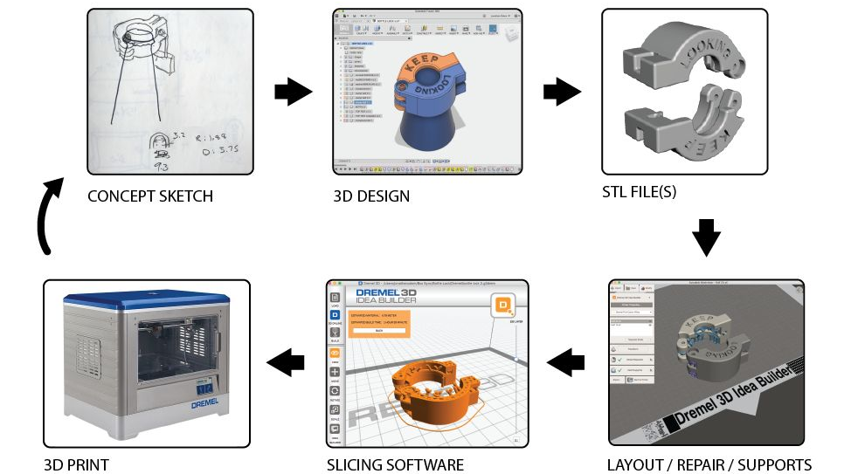
Notes:
3D printing allows us to make mistakes faster. The digital design to quick physical product means that we can see quickly what needs to be changed and act accordingly.

Slide 7
Why 3D Print?

Slide 8
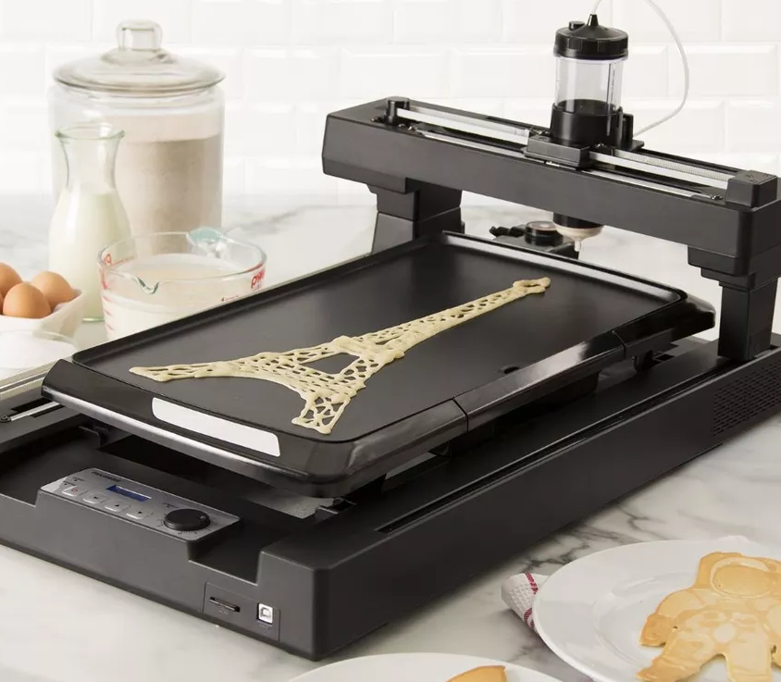
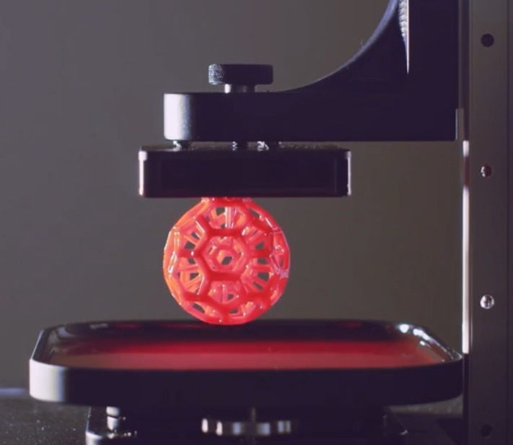
Various Materials and Technologies
Notes:
Pancake 3D printer: http://www.pancakebot.com/
On the right: DLP

Slide 9
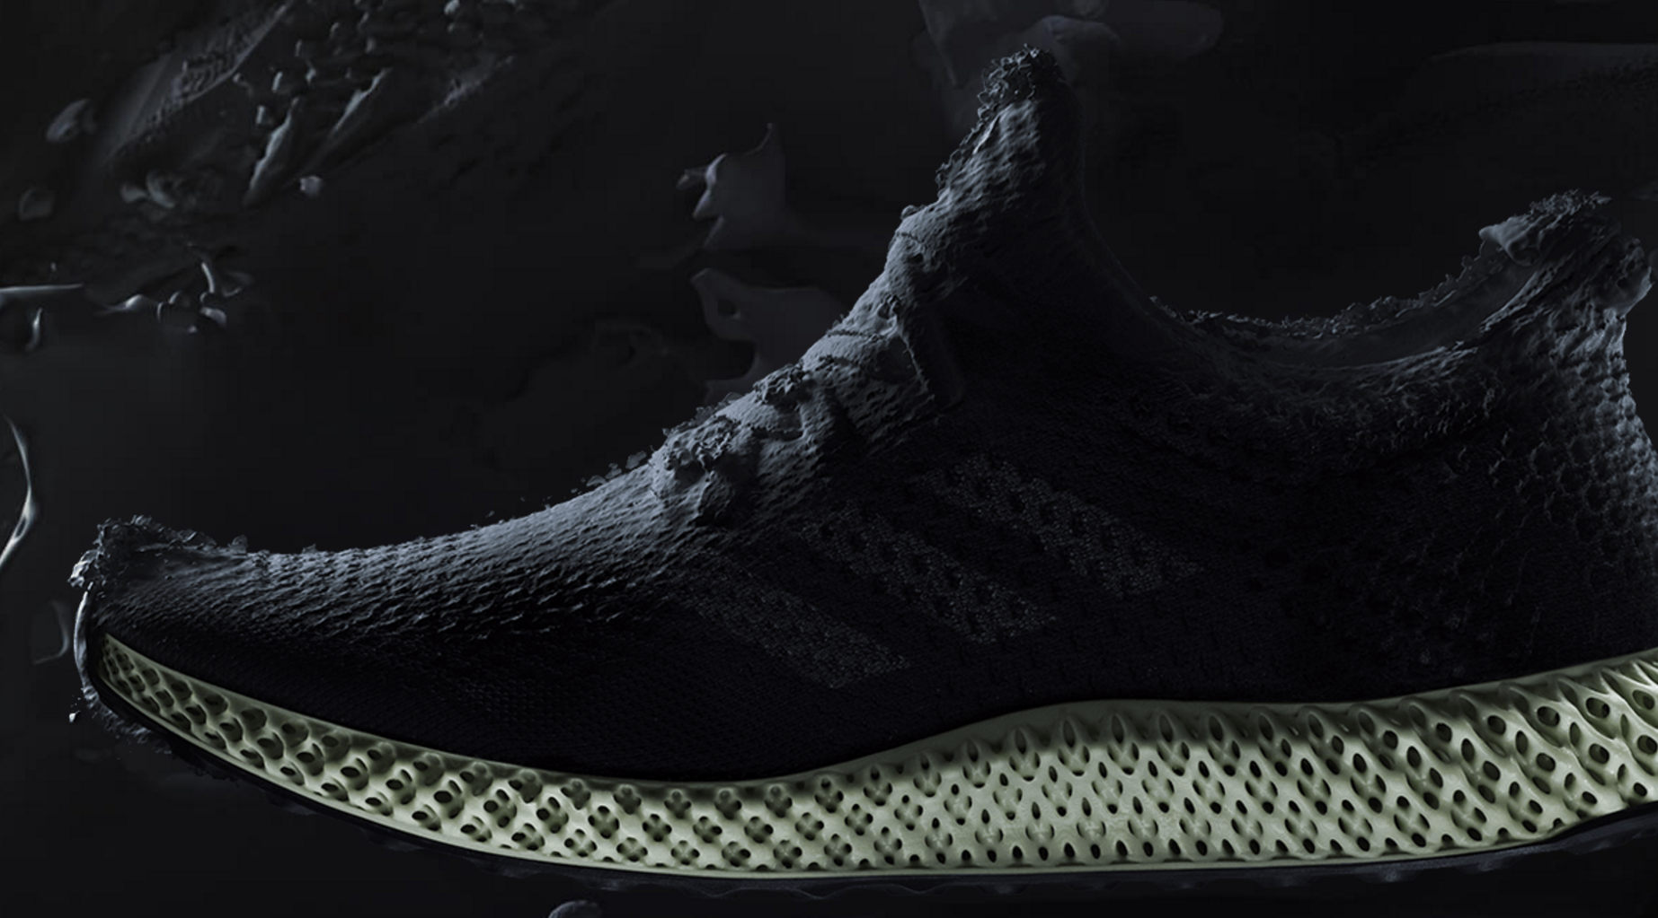
Complex Shapes
Notes:
Adidas has been playing with 3D Printed Soles https://www.theverge.com/2017/4/7/15216724/adidas-3d-printed-sneaker-futurecraft
Futurecraft 4D http://www.adidas.com/us/futurecraft

Slide 10
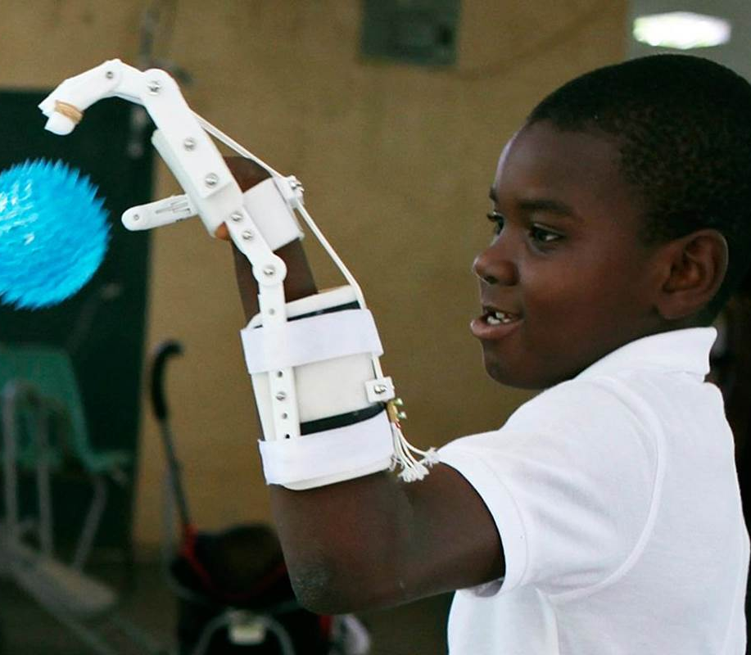
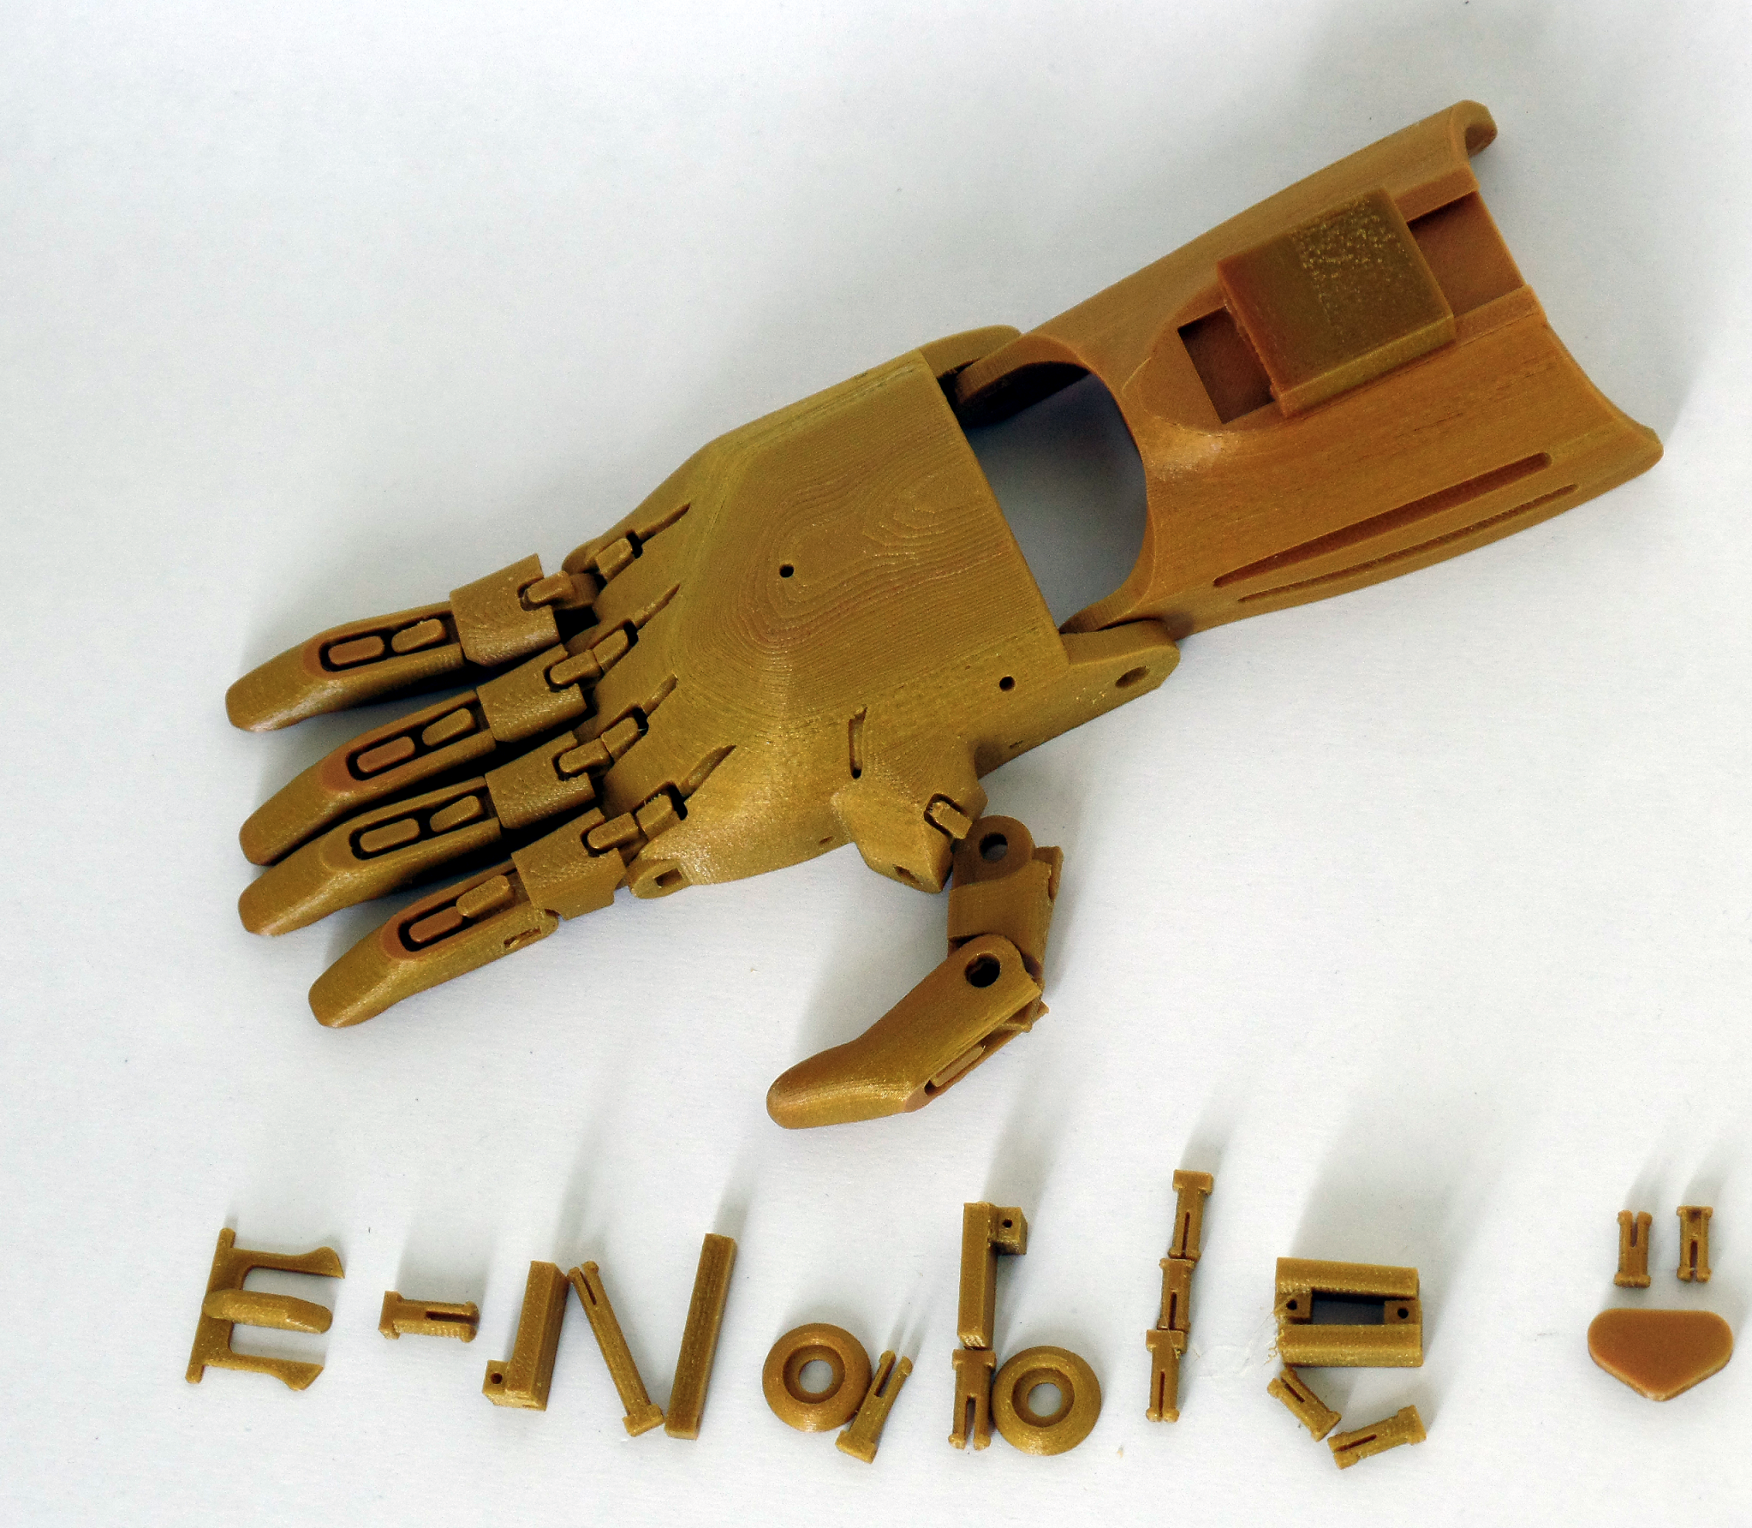
Customization

Slide 11
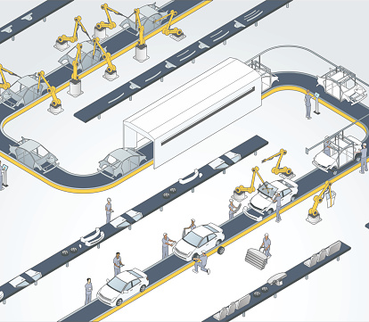
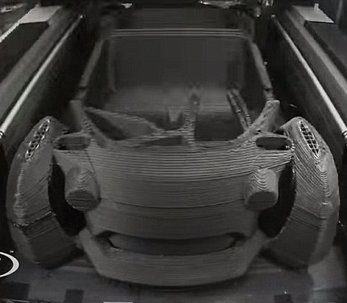
Single Tool Low Cost
Notes:
Imagine if you have an idea

Slide 12
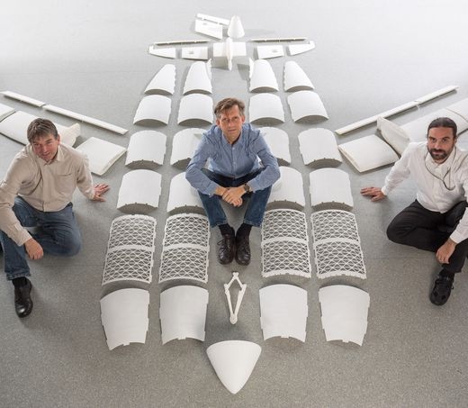
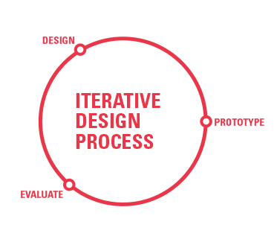
Rapid Prototyping

Slide 13
Why Not 3D Print?

Slide 14
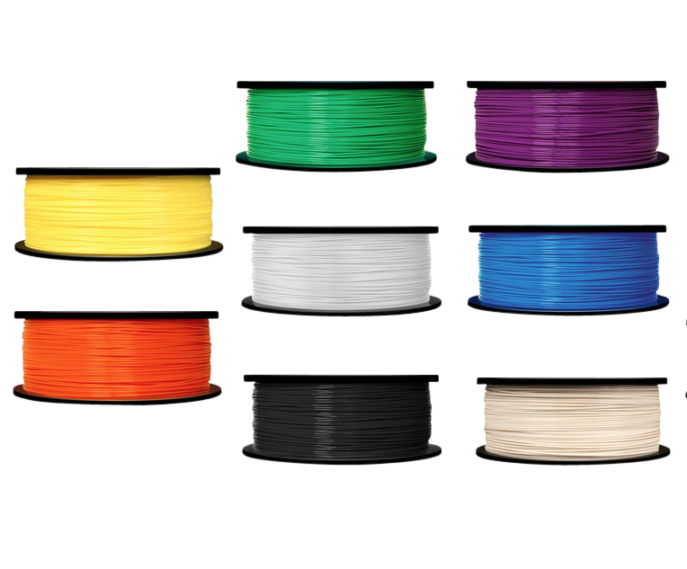
Limited Material Choice
50 Shades of PLASTIC
PLA
ABS
PETG
Notes:
Even martha stewart is into 3D printing! https://www.makerbot.com/media-center/2014/11/17/martha-stewart-technology-palette-imagination instead of yellow it’s lemon drop

Slide 15
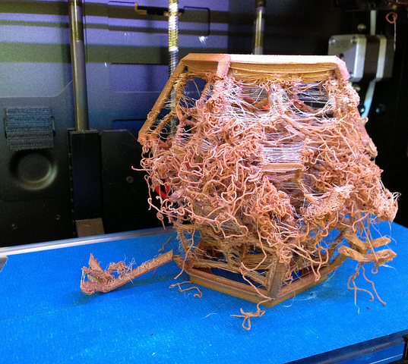
Can Be Unreliable
Notes:
Failed print left overnight

Slide 16
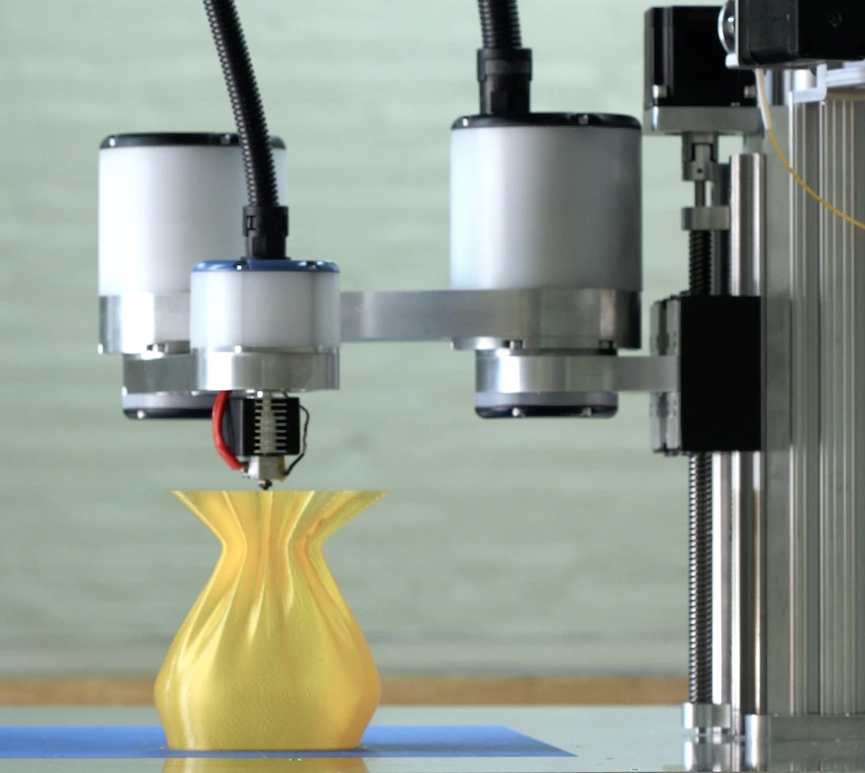
Low Precision and Strength
Notes:
The nature of thermoplastic means that they will shrink, but not the same in every direction. It is okay for prototyping work but might not be suitable for production. The part also shrinks differently in each x, y, and z dimension. If absolute precision is needed, measure how much the part shrank in each direction and offset that amount in your digital design and rinse and repeat.

Slide 17
Who Uses 3D Printers?

Slide 18
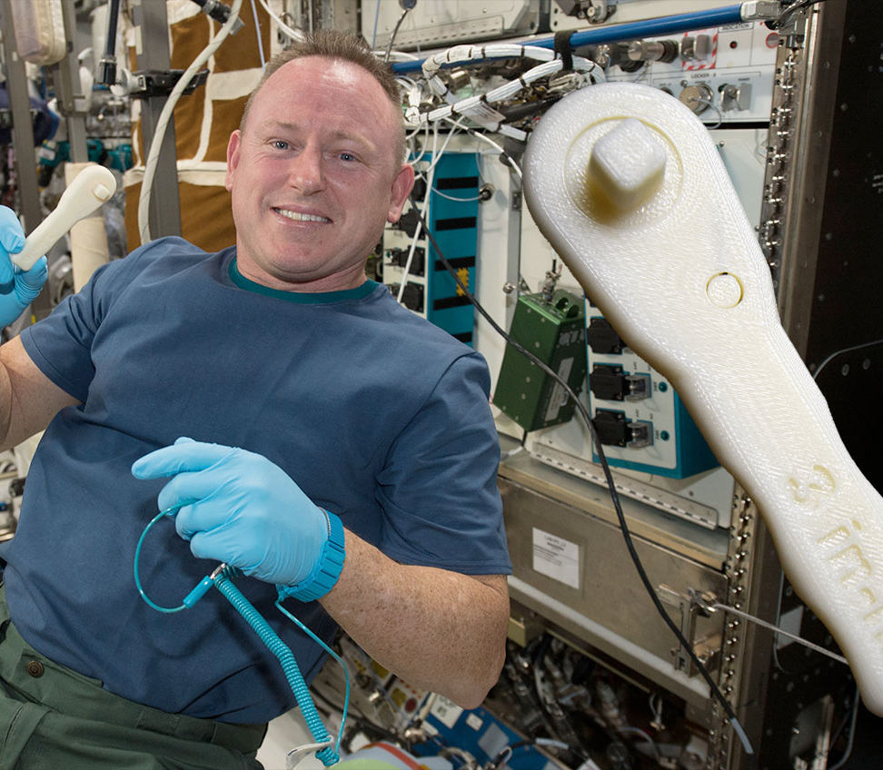
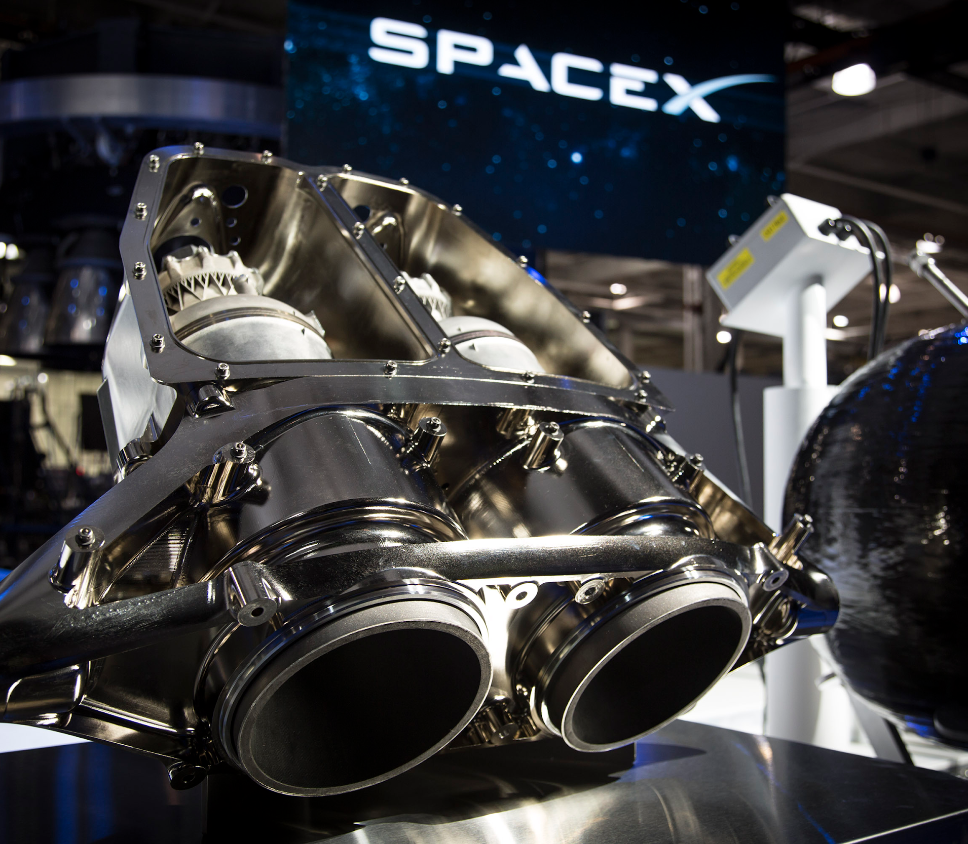
Aerospace
Notes:
On the left: commander wilmore with 3D printed ratchet wrench on ISS https://www.nasa.gov/mission_pages/station/research/news/3Dratchet_wrench
On the right: spacex 3d printed engine
http://www.spacex.com/news/2014/07/31/spacex-launches-3d-printed-part-space-creates-printed-engine-chamber-crewed
https://en.wikipedia.org/wiki/SuperDraco

Slide 19
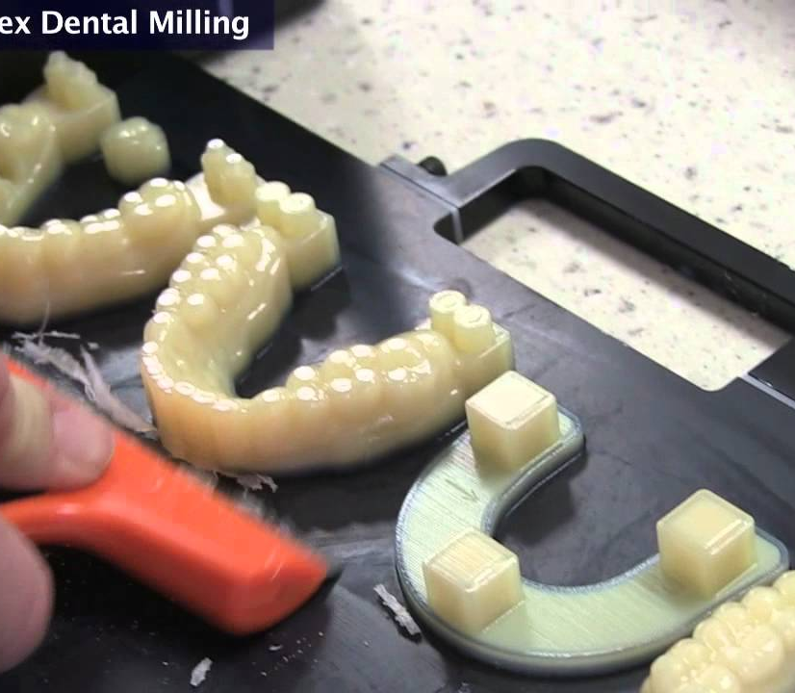
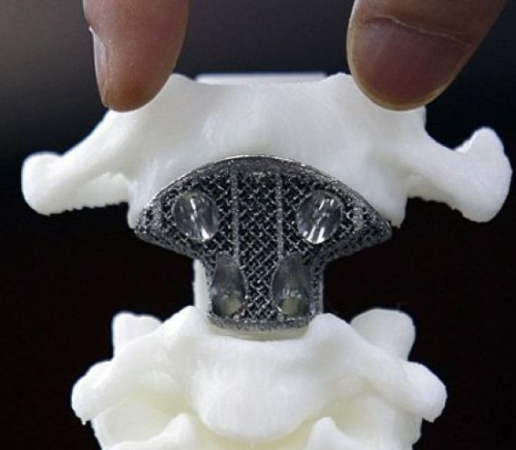
Medical
Notes:
On the left: crown or bridge from digital scans with stratasys objet with apex dental milling
On the right: 3D printed titanium c3 https://3dprint.com/140840/patient-china-spinal-implant/

Slide 20
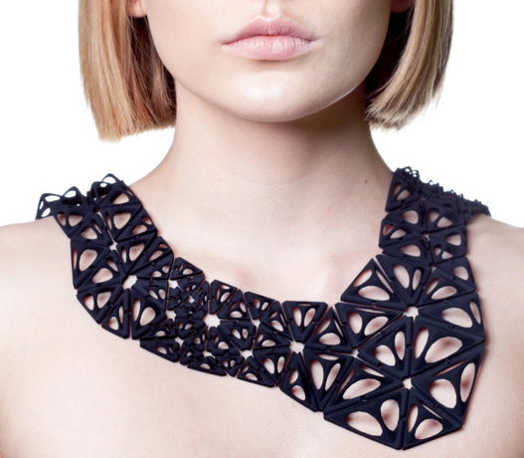
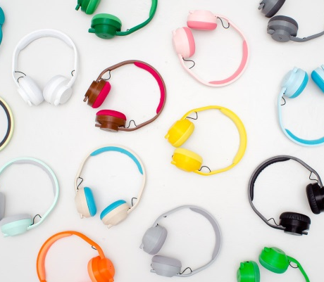
Designers & Entrepreneurs

Slide 21
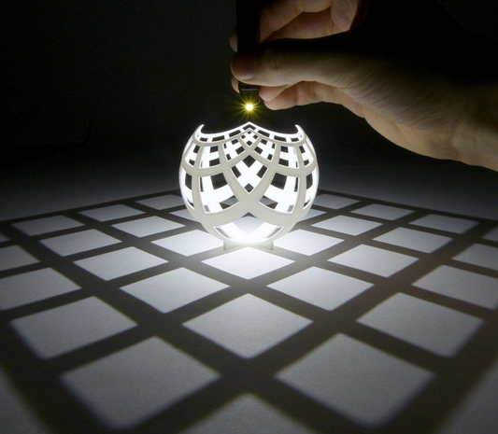
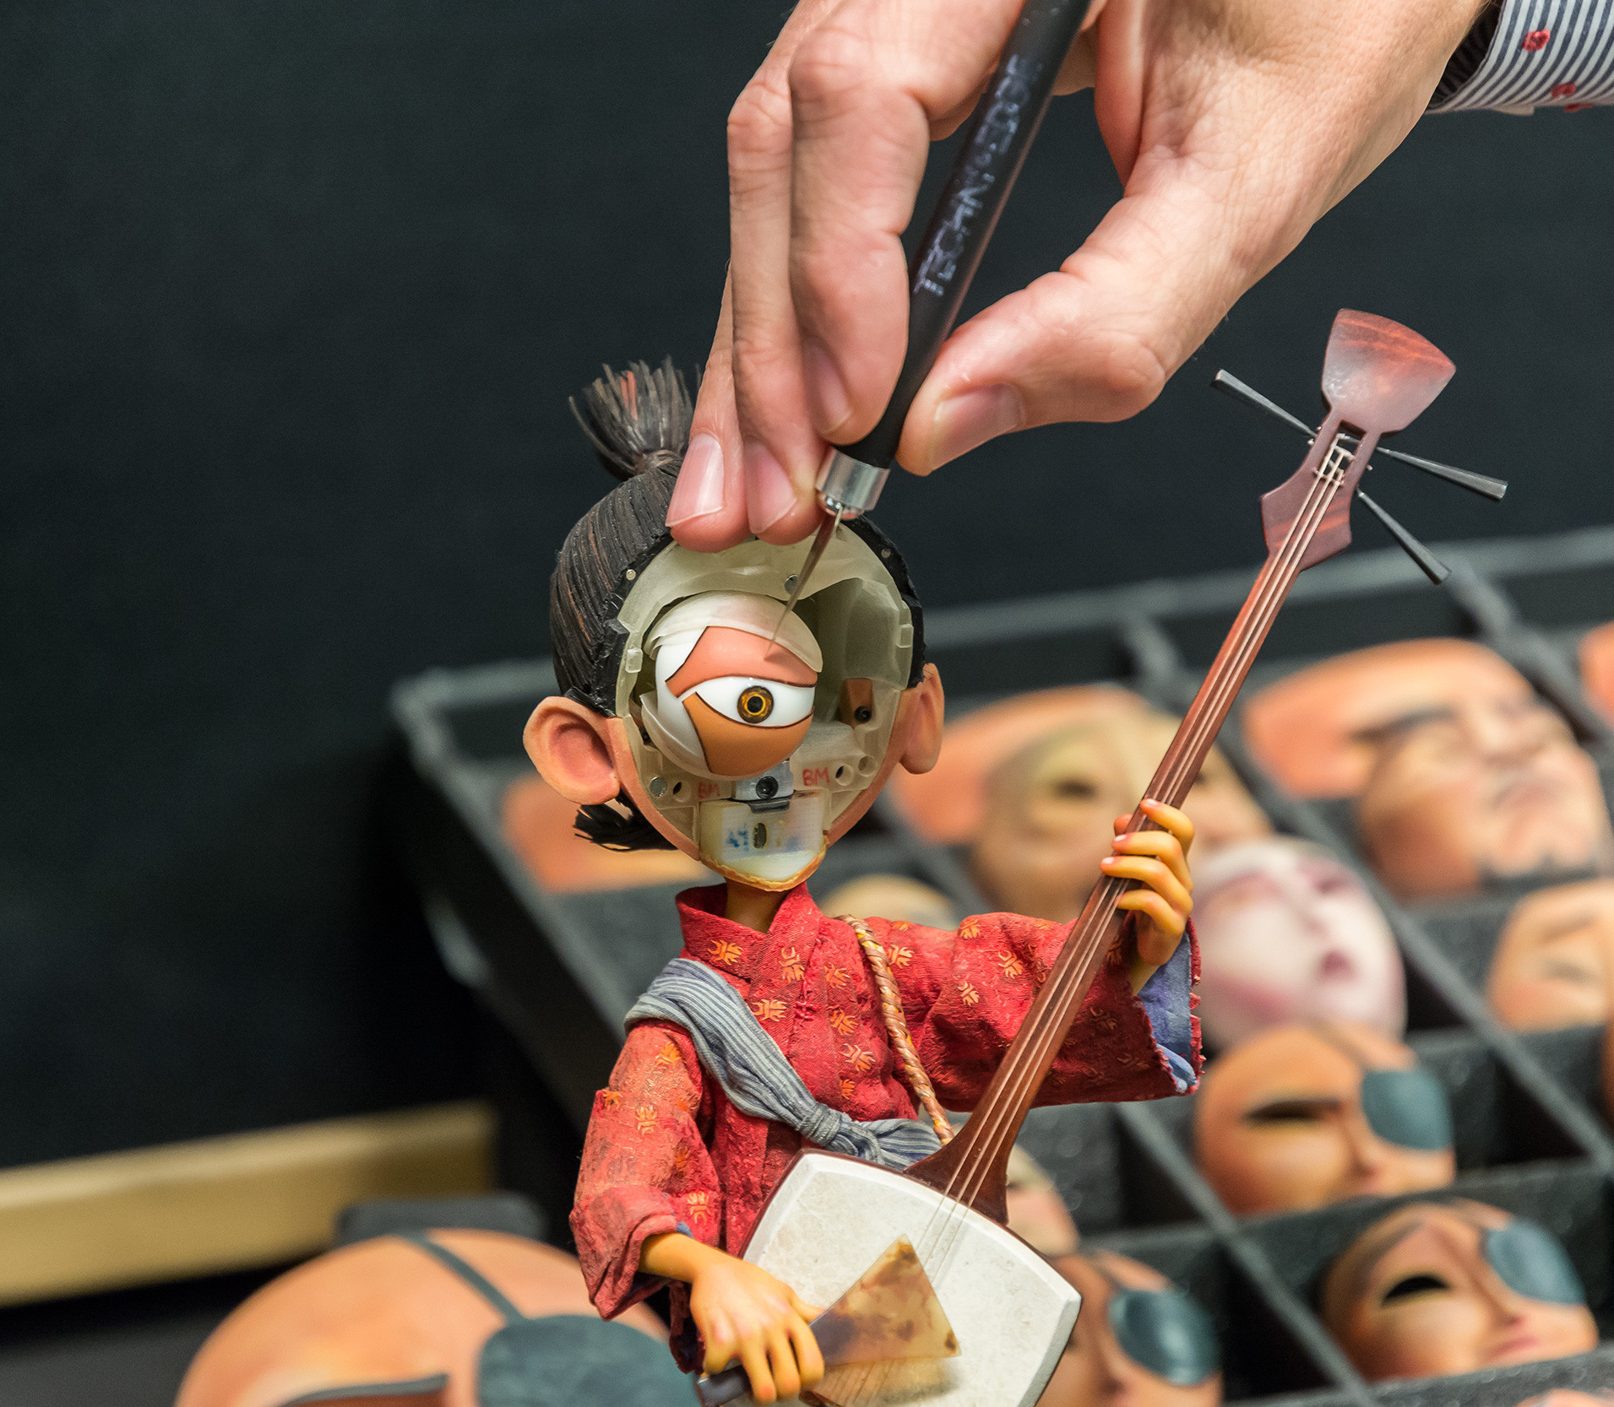
Artists

Slide 22
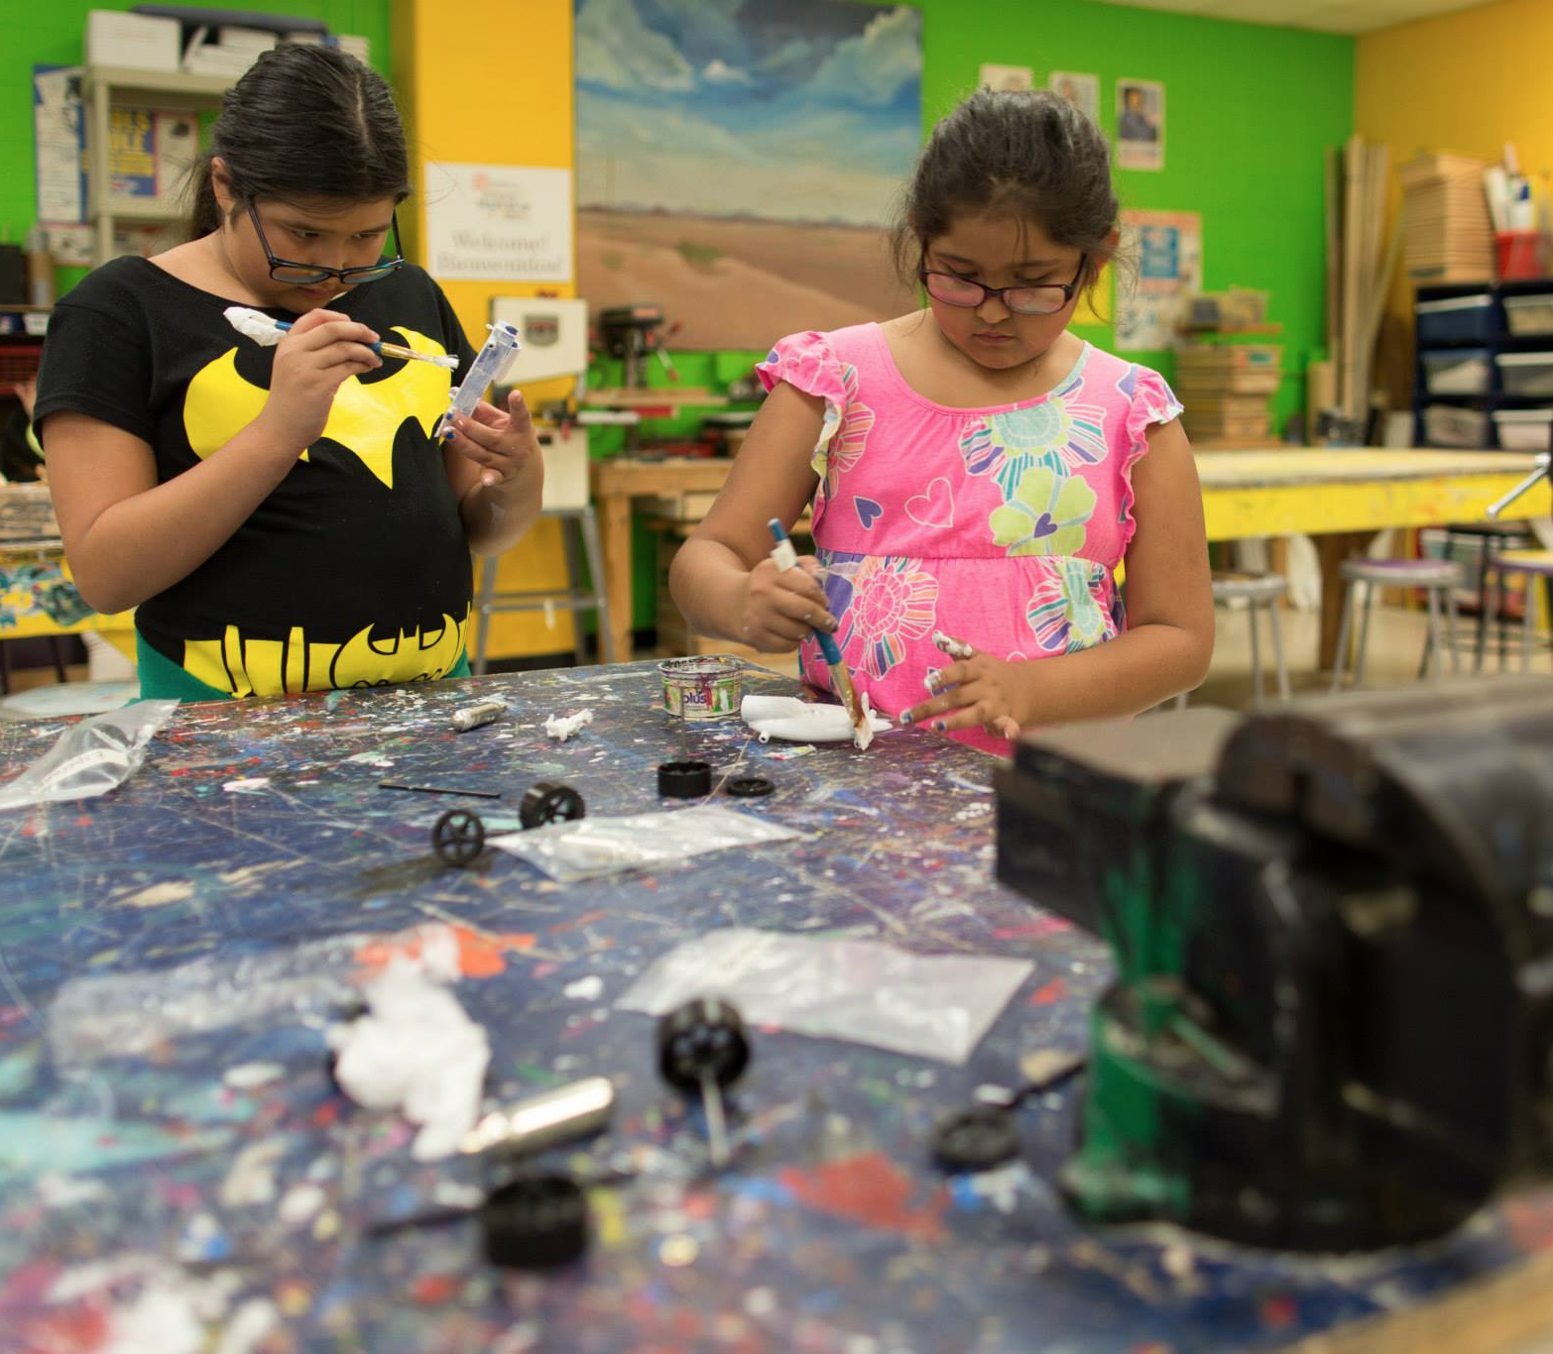
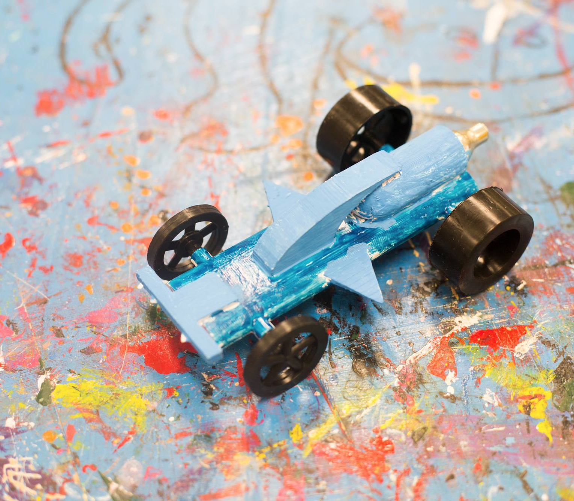
Students

Slide 23
Getting 3D Models
Create Your Own
3DSlash
TinkerCAD
Fusion 360
Inventor
3DS Max
Blender
Maya
Onshape
Find Design Online
Youmagine
Thingiverse
MyMinifactory
3DHubsPicks

Slide 24
Slicing Into Layers
Cura
Simplify3D
Slic3r

Slide 25
Printing
Printability
Check Minimum Wall Thickness with 3D Hubs - at least 2mm
Size Limitations
Size of print is limited by size of 3D Printer
Scale down
Divide into multiple parts

